Slide 1
Project Title
AI-Based Code Explanation & Documentation Generator
Name:
Sushma Bhushan
Date:
03-06-2026

Slide 2



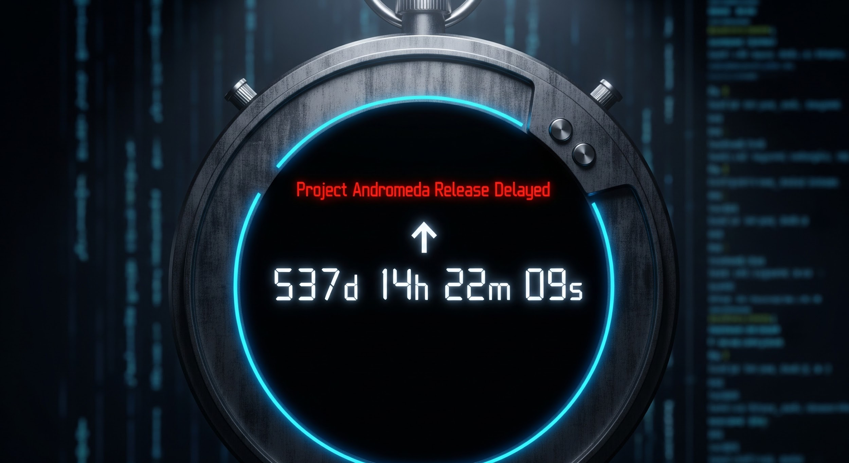
Problem Statement:
No Auto-Docs
Developers spend hours writing READMEs and architecture docs manually.
Context Switching
Engineers lose productivity jumping between code and documentation tools.
Inconsistency
Quality varies widely across teams, making onboarding slow and error-prone.
Slow PR Reviews
Undocumented code increases review time and delays releases significantly.
"The gap between writing code and documenting it costs teams thousands of hours annually."

Slide 3

Project Overview: What is it?
Definition
•Automated pipeline pulling from Trigger
•Performs static analysis & LLM prompting
•Generates explanations, READMEs, & API docs
•Creates inline comments & architecture summaries
•Suggests tests and improvement notes
Key Facts
Trigger: Manual trigger
AI Engine: Gemini AI LLM - GPT models
Workflow: n8n No-Code Pipeline
Output: documentation
Notify: Email summary

Slide 4


Automated AI Documentation Pipeline
01
Trigger
Execute workflow button
02
Fetch
GitHub / HTTP Node downloads repository files
03
Parse
Function / Code Parser identifies code files
04
LLM Generate
GeminiAI Node generates README & comments
05
Post-process
Function node formats markdown & metadata
06
Commit
Google Drive node saves outputs
07
Notify
Email node sends summary link

Slide 5
Tools, APIs & n8n Nodes Used
🔧 n8n Nodes
🌐 Tools & APIs
Manual Trigger
Edit Fields
Code in JavaScript
GitHub (List Files, Get File)
Extract from File
AI Agent
Basic LLM Chain
Google Drive (Upload)
Gmail
AI: Google Gemini API
Source: GitHub API
Storage: Google Drive
Notify: Gmail

Slide 6
Sample Input & Output
📥 Sample Input
📤 Sample Output
1) documentation.md
AI-generated project documentation uploaded to Google Drive
2) Gmail Alert
"AI Documentation Generated — view file link attached"
Webhook Payload
Repo URL: https://github.com/username/repo-name
Triggers whenever a developer pushes code or opens a Pull Request on the monitored repository.

Slide 7
Target Audience & Stakeholders
👨‍💻 Developers
Save hours on documentation. Focus on writing code, not describing it. Get auto-generated inline comments and READMEs instantly.
🧑‍🎓 Onboarding Engineers
Understand new codebases faster with auto-generated architecture summaries and component explanations.
🏗 Engineering Managers
Enforce documentation standards across teams without manual reviews. Ensure every PR is documented before merge.
✍️ Technical Writers
Use AI-generated drafts as a starting point. Spend time on quality edits rather than starting from scratch.

Slide 8
Business Value & Operational Impact
↓70%
↑3x
↓40%
100%
Docs writing time
Onboarding speed
PR review time
Coverage on push

Slide 9
Core Value Deliverables
check_circle
Faster Onboarding
New developers understand code structure immediately through AI-generated architecture summaries.
check_circle
Consistent Documentation
Uniform doc style enforced automatically across all repos and teams — no more guessing.
check_circle
Fewer Misunderstandings
Human-readable explanations reduce back-and-forth between developers and stakeholders.
check_circle
Improved Maintainability
Well-documented code is easier to refactor, debug, and handoff to new owners.
check_circle
Reduced PR Review Time
Reviewers spend less time decoding logic when every PR ships with auto-generated context.
check_circle
Zero Extra Effort
Fully automated on push/PR — developers get documentation without changing their workflow.

Slide 10
Workflow Transformation: Before vs. After
❌ Before
✅ After
Developers write docs manually — slow and inconsistent
READMEs often missing or outdated after updates
No architecture docs for new joiners
Hours lost to PR back-and-forth asking 'what does this do?'
Documentation is an afterthought, done (if ever) at release
Docs auto-generated on every push — zero developer effort
README always up-to-date and synced with latest code
Architecture summary ready for day-one onboarding
PR reviewers have full context before they open the diff
Documentation is continuous and happens in real time

Slide 11
Project Summary & Conclusion
The AI-Based Code Explanation & Documentation Generator is an end-to-end agentic pipeline built on n8n that automatically transforms raw code into structured, human-readable documentation. It eliminates manual documentation effort, enforces consistency, and delivers value to developers, managers, and technical writers — all triggered by a simple GitHub push.
🤖 LLM-Powered
⚡ Fully Automated
🔗 GitHub Native
📋 Always Up-to-Date
🌐 No-Code (n8n)
📣 Slack/Email Notify

Slide 12
THANK YOU!

